Slide 1
Topic: Quadratics EQ: What is quadratics?

Slide 2
WHY
Quadratic equations are commonplace in theoretical and practical applications of mathematics. They are used to solve problems in geometry and measurement as well as in number theory and physics.
The path that a projectile takes while flying through the air, for example, can be analysed using quadratic equations.

Slide 3
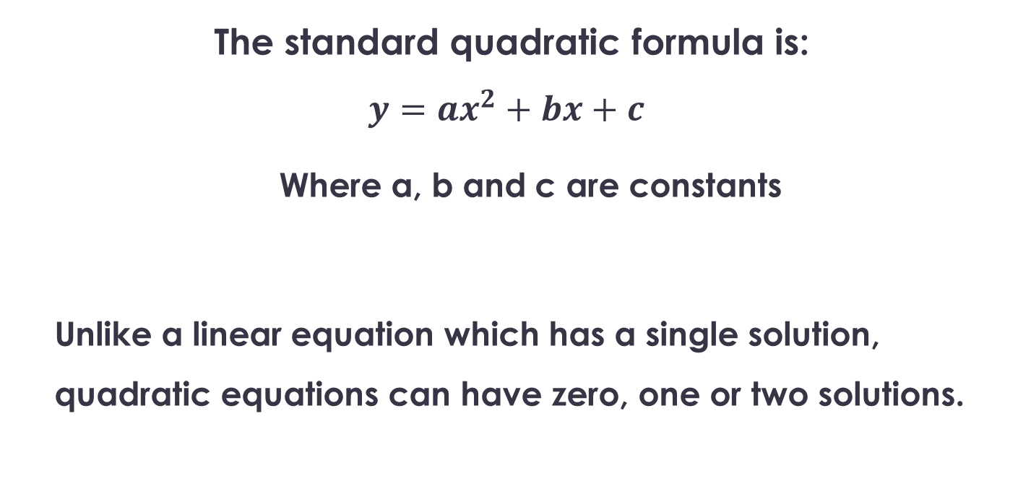
Topic: Quadratics EQ: What is quadratics?
The standard quadratic formula is:
$$y=ax^{2}+bx+c$$
Where a, b and c are constants
Unlike a linear equation which has a single solution, quadratic equations can have zero, one or two solutions.
The formula?
How is it different from a linear equation?

Slide 4
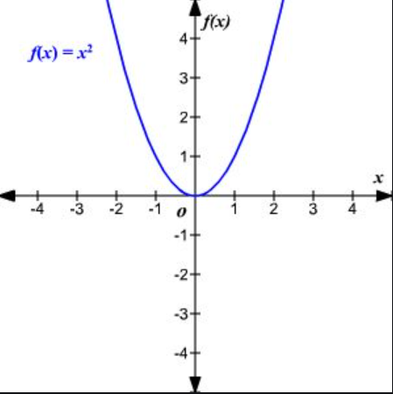
What is a Quadratic Function?
Definition
What does it look like?
A Quadratic Function is a relationship between x and y where the highest power of x is 2.
U Shape curve
Symmetrical
Increases in steepness as it progresses
One “turning point”

Slide 5
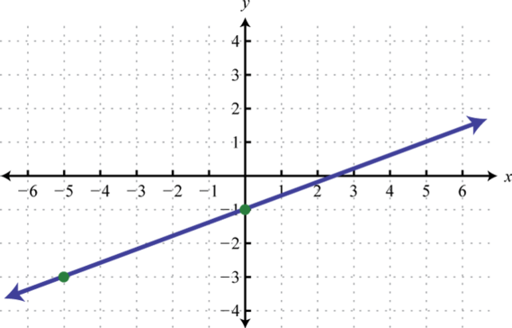
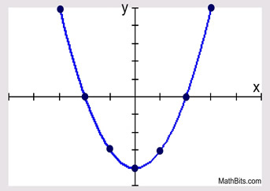
Topic: Quadratics EQ: What is quadratics?
Notes:
Linear:
One x value for every y value
Quadratics:
Two x values for most y values

Slide 6
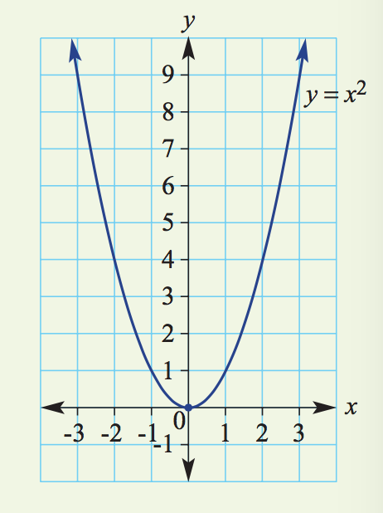
24
7
30
Date
Quadratics
EQ: What is Quadratics
What is a parabola?
A parabola is the graph of a quadratic relation.
The basic parabola has the rule y = x².
Features of a parabola
– The vertex (or turning point) is (0, 0). – It is a minimum turning point.
– Axis of symmetry is x = 0. – y-intercept is (0, 0). – x-intercept is (0, 0).
5

Slide 7
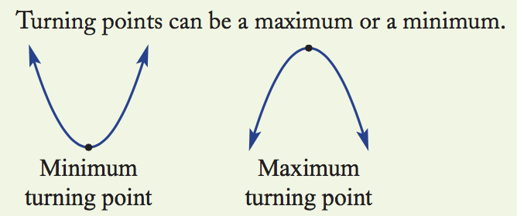
24
7
30
Date
Quadratics
EQ: What is Quadratics?
What is a Turning Point?
The turning point is the point in which the parabola changes direction
Concave up
If positive, ie y=3x² the parabola opens up
If negative, ie y=-3x² the parabola opens down
This is also know as
Concave down
5

Slide 8
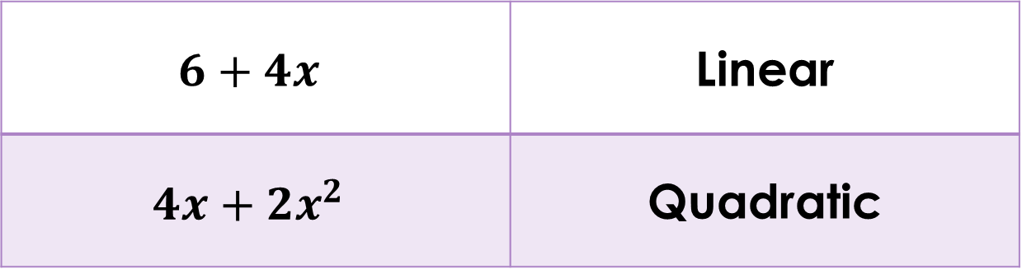
Topic: Quadratics EQ: What is quadratics?
How is it different from a linear equation?
$$6+4x$$ | Linear
$$4x+2x^{2}$$ | Quadratic
Binomial
(power of 2)

Slide 9
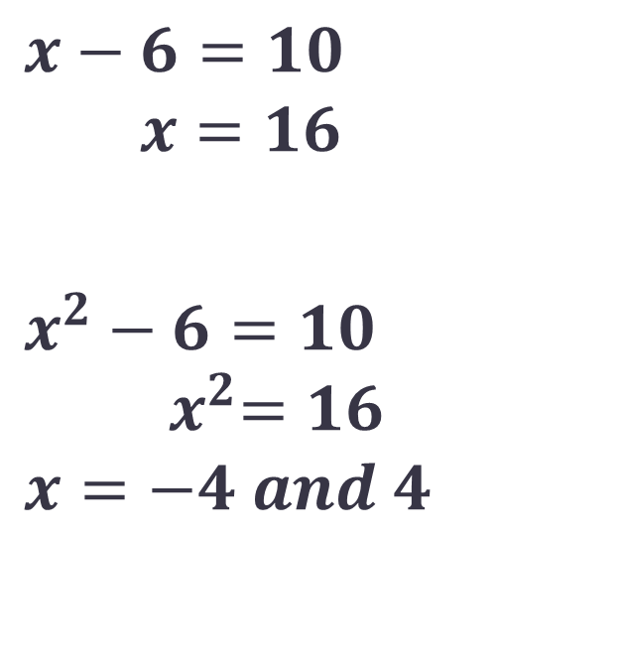
Topic: Quadratics EQ: What is quadratics?
How is it different from a linear equation?
$$x−6=10$$
$$x=16$$
$$x^{2}−6=10$$
$${ x}^{2}=16$$
$$x=−4 and 4$$
Linear
Quadratic

Slide 10
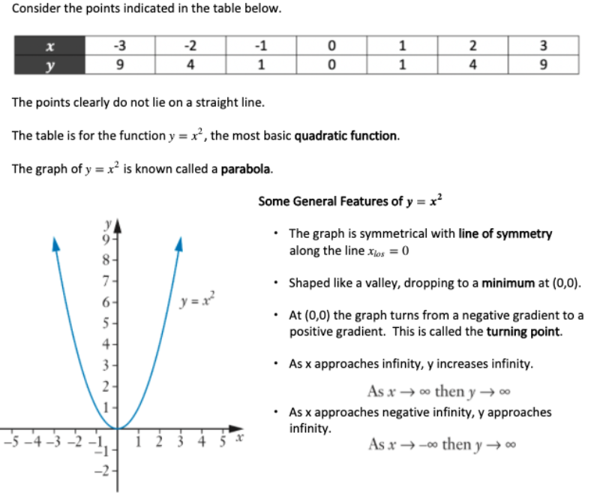
First look

Slide 11
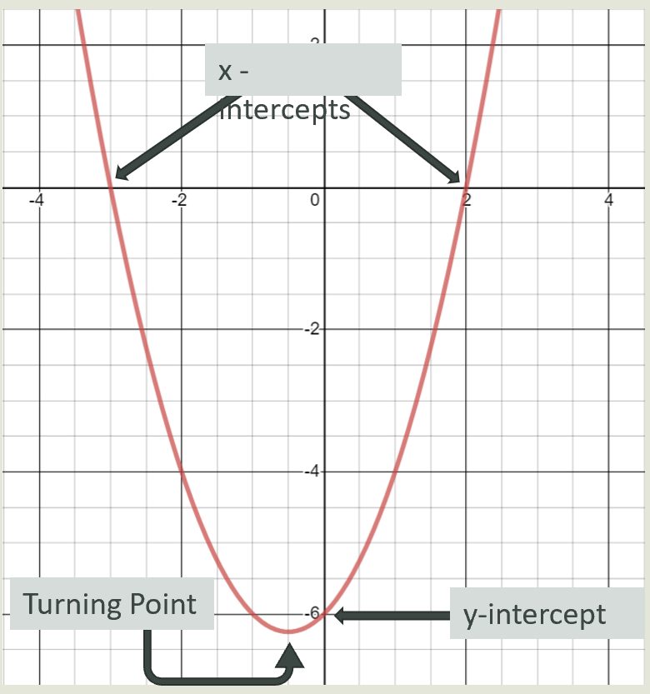

Slide 12
24
7
30
Topic: Quadratics
Date
EQ – What is a quadratic?
How do I subsitute values into a table?
Step 1. To graph a parabola create a table with x values
Step 2. Substitute the x values into the equation
Graph the equation y = x²
x | -3 | -2 | -1 | 0 | 1 | 2 | 3
y | 9
y = x²
y = ( )²
y =
4

Slide 13
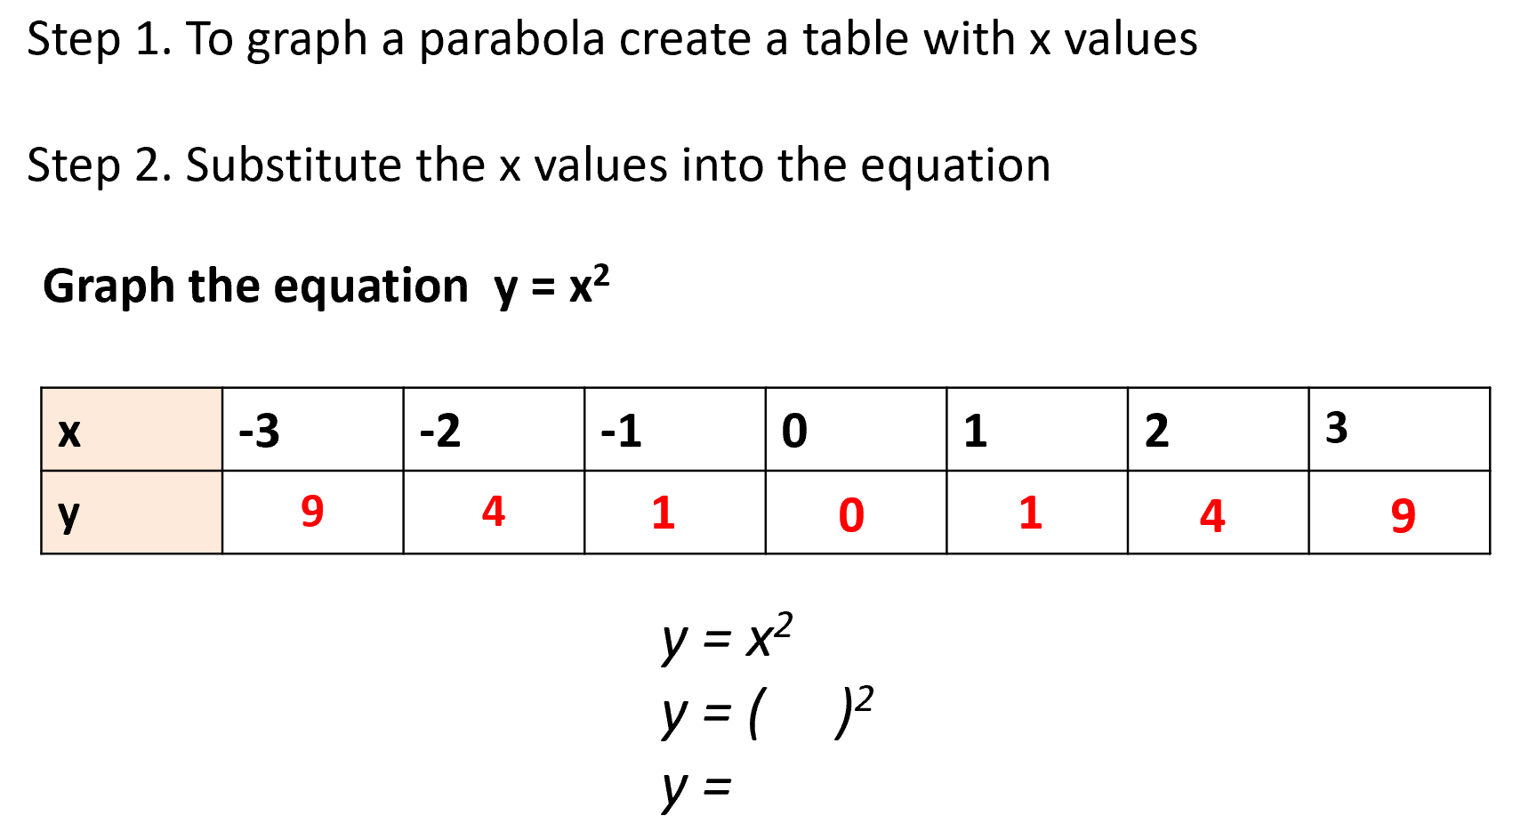
24
7
30
Topic: Quadratics
Date
EQ – What is a quadratic?

Slide 14
24
7
30
Topic: Graphing Quadratic Equation
Date
EQ – What information do we need to graph a parabola?
Step 1. To graph a parabola create a table with x values
Step 2. Substitute the x values into the equation
Graph the equation y = x²
x | -3 | -2 | -1 | 0 | 1 | 2 | 3
y | 9 | 4
1
0
1
4
9
This gives us the coordinates that we can graph.
(-3, 9), (-2, 4), (-1, 1), (0, 0), (1, 1), (2, 4), (3, 9)

Slide 15
On your graph provided, plot the following points and connect with a smooth line
Rule: y = x²
X | -4 | -3 | -2 | -1 | 0 | 1 | 2 | 3 | 4
y | 16 | 9 | 4 | 1 | 0 | 1 | 4 | 9 | 16

Slide 16
In your books, create a table of values for the following rule, plot the following points and connect with a smooth line
Rule: y = x² - 1
X | -4 | -3 | -2 | -1 | 0 | 1 | 2 | 3 | 4
y

Slide 17
In your books, create a table of values for the following rule, plot the following points and connect with a smooth line
Rule: y = x² + 2
X | -4 | -3 | -2 | -1 | 0 | 1 | 2 | 3 | 4
y

Slide 18
In your books, create a table of values for the following rule, plot the following points and connect with a smooth line
Rule: y = x² - 5
X | -4 | -3 | -2 | -1 | 0 | 1 | 2 | 3 | 4
y

Slide 19
In your books, discuss the impact of changing the number added or taken from y = x²

Slide 20
On your graph paper, plot the following points and connect with a smooth line
Rule: y = - x²
X | -4 | -3 | -2 | -1 | 0 | 1 | 2 | 3 | 4
y | -16 | -9 | -4 | -1 | 0 | -1 | -4 | -9 | -16

Slide 21
In your books, create a table of values for the following rule, plot the following points and connect with a smooth line
Rule: y = - x² + 2
X | -4 | -3 | -2 | -1 | 0 | 1 | 2 | 3 | 4
y

Slide 22
In your books, create a table of values for the following rule, plot the following points and connect with a smooth line
Rule: y = - x² - 4
X | -4 | -3 | -2 | -1 | 0 | 1 | 2 | 3 | 4
y

Slide 23
In your books, create a table of values for the following rule, plot the following points and connect with a smooth line
Rule: y = - x² + 8
X | -4 | -3 | -2 | -1 | 0 | 1 | 2 | 3 | 4
y

Slide 24
In your books, describe the impact of change the x² to – x² in the equation y = x²

